Slide 1

uploading of physical grievance applications and other actions on cpengrams portal
Department of Pension & Pensioners’ Welfare

Slide 2
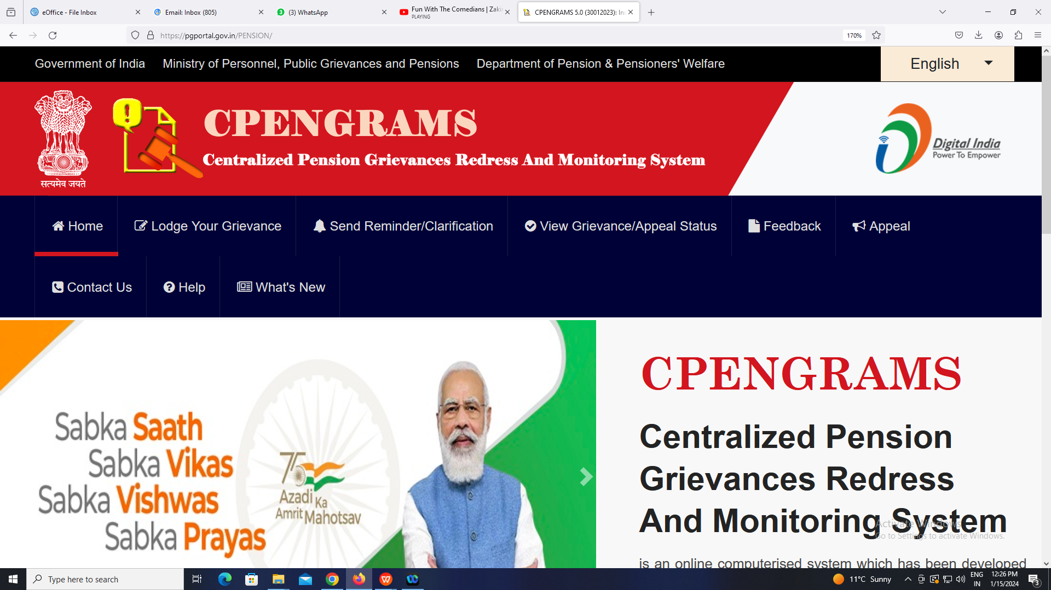
type pgportal .gov.in/pension/

Slide 3
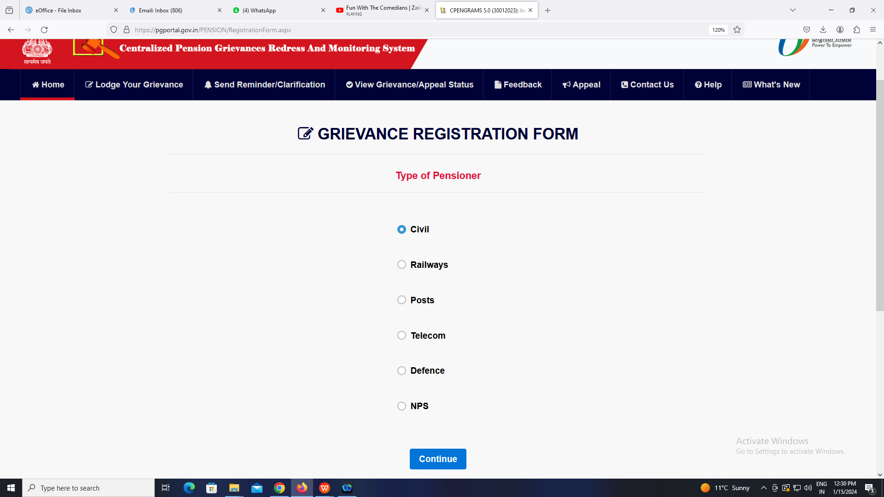
click
“lodge YOUR grievance”

Slide 4
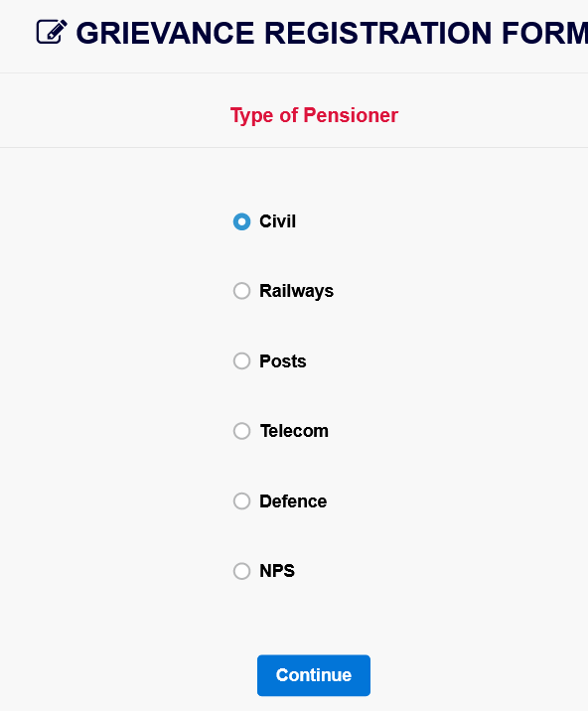
select
“Type of pensioner” & click “continue”

Slide 5
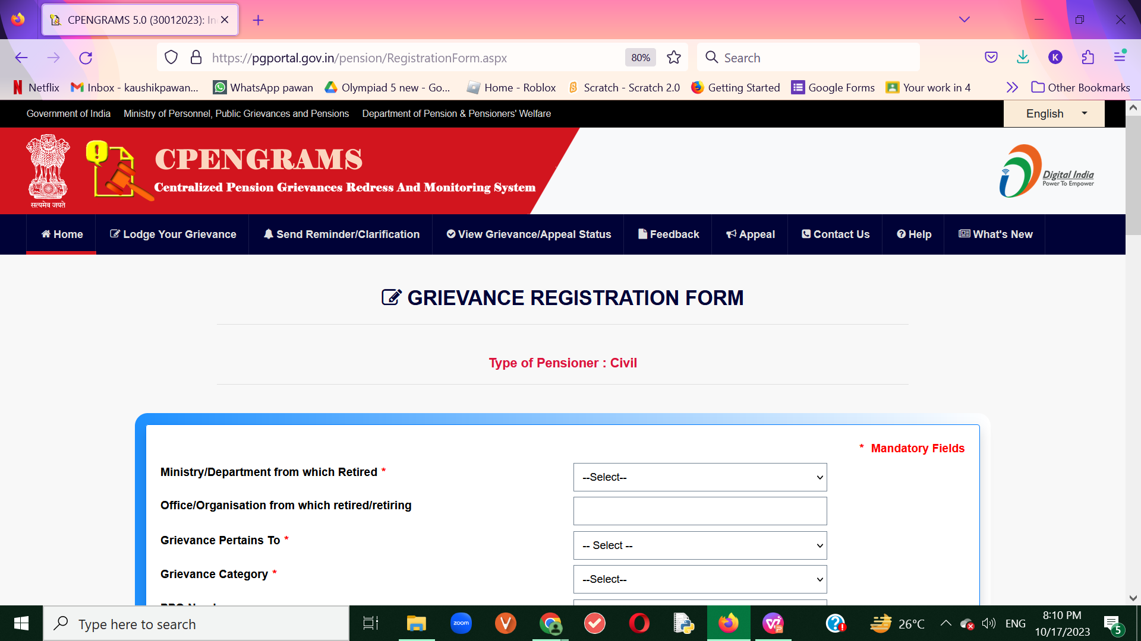
Fill in MANDATORY FIELDS
(FILL in MOBILE No. OF APPLICANT)

Slide 6
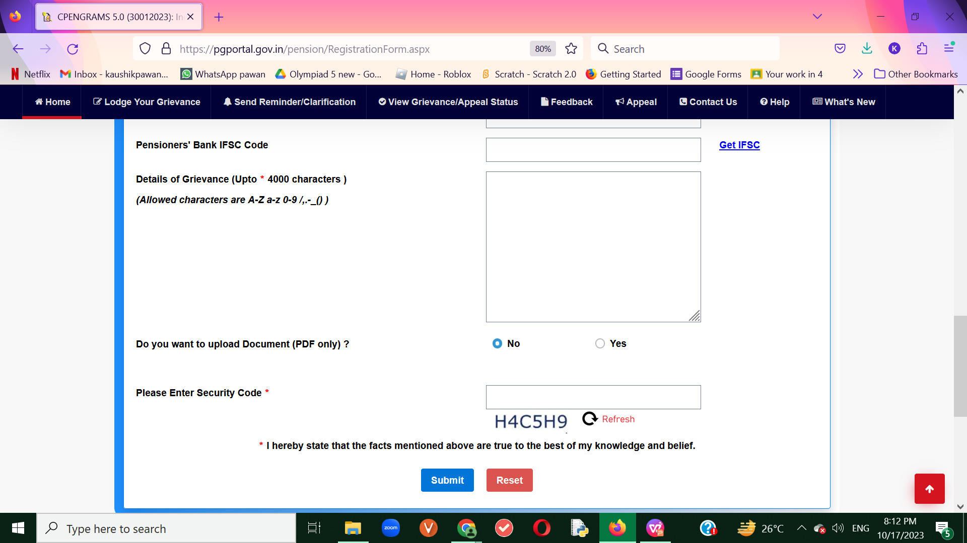
FILL in
DETAILS - 4000 WORDS
AND/or PDF ATTACHMENT

Slide 7
CLICK
“sUBMIT”

Slide 8
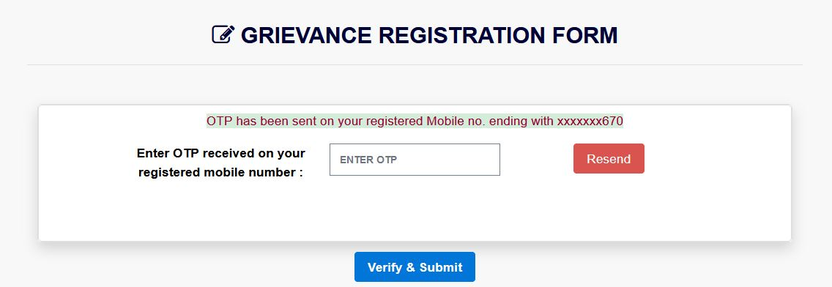
ENTER OTP SENT ON
MOBILE NO. OF APPLICANT

Slide 9
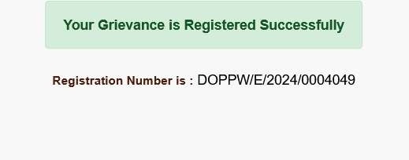
SAVE REGISTRATION No. SENT ON
MOBILE No. OF APPLICANT

Slide 10
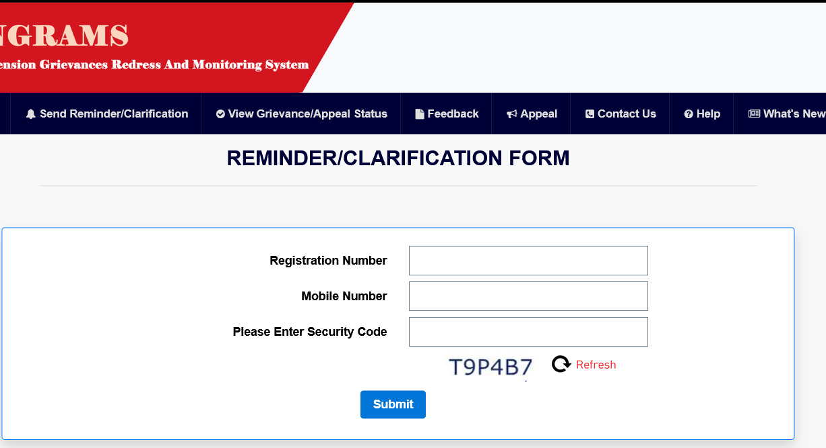
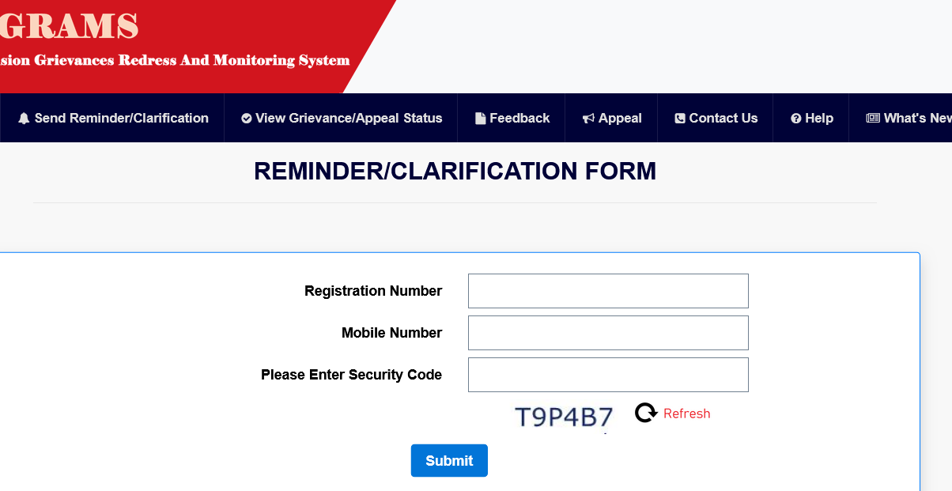
click “REMINDER” :if delayed
(FOR APPLICANT)

Slide 11
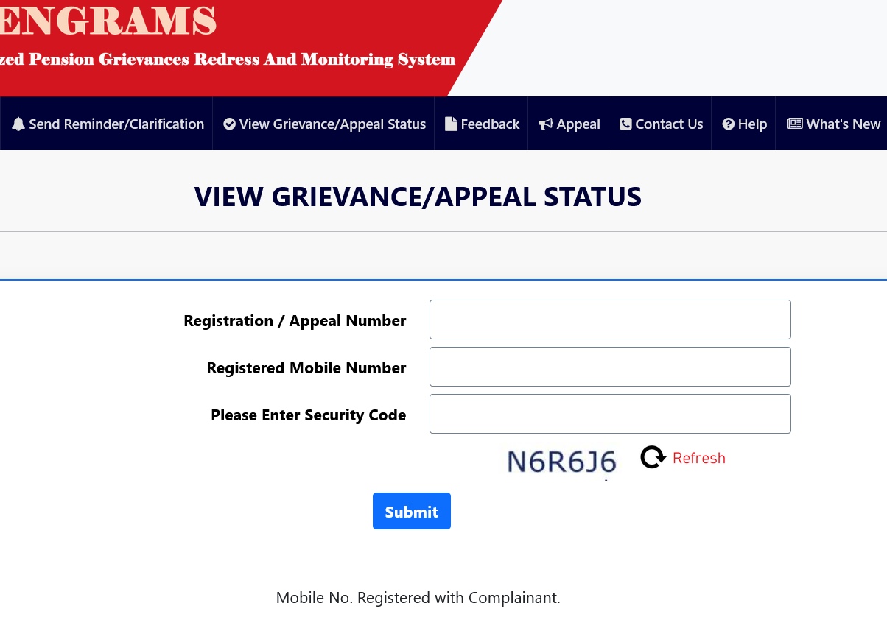
click “status” : FOR pendency level
(FOR APPLICANT)

Slide 12
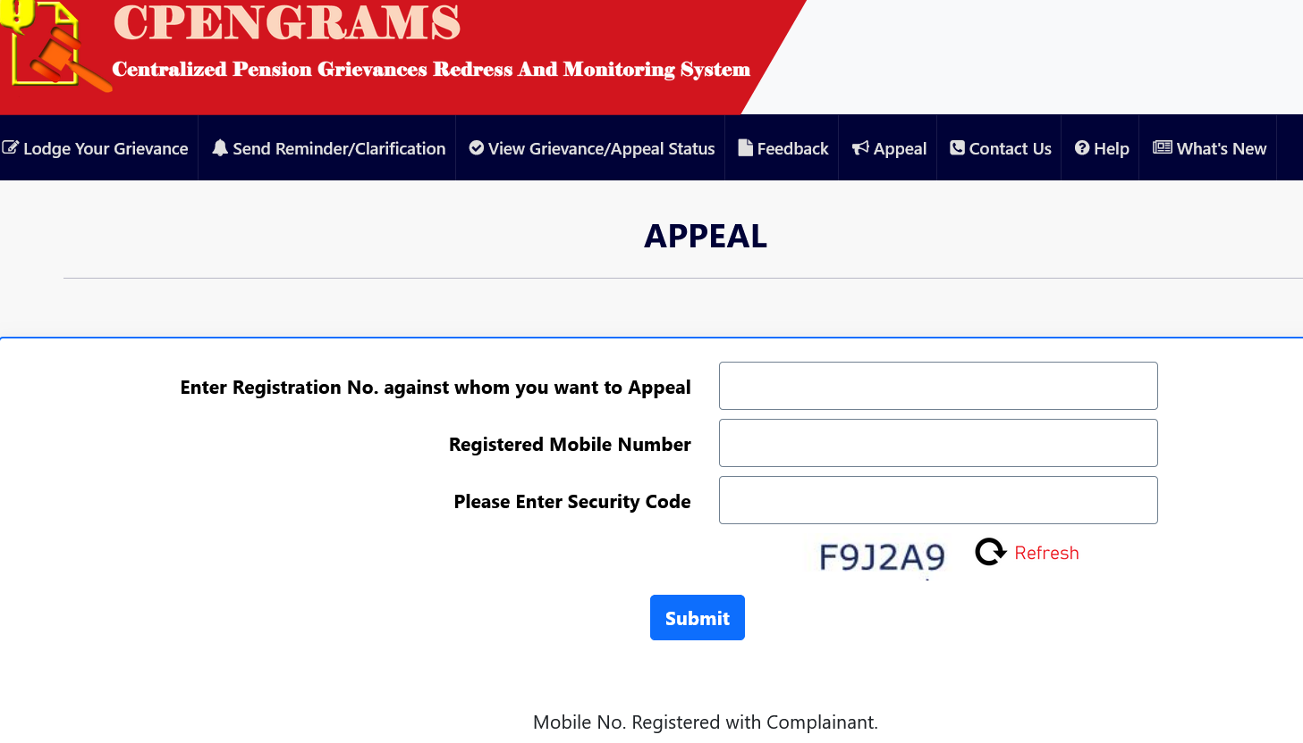
click “appeal” : if not satisfied
(FOR APPLICANT)

Slide 13
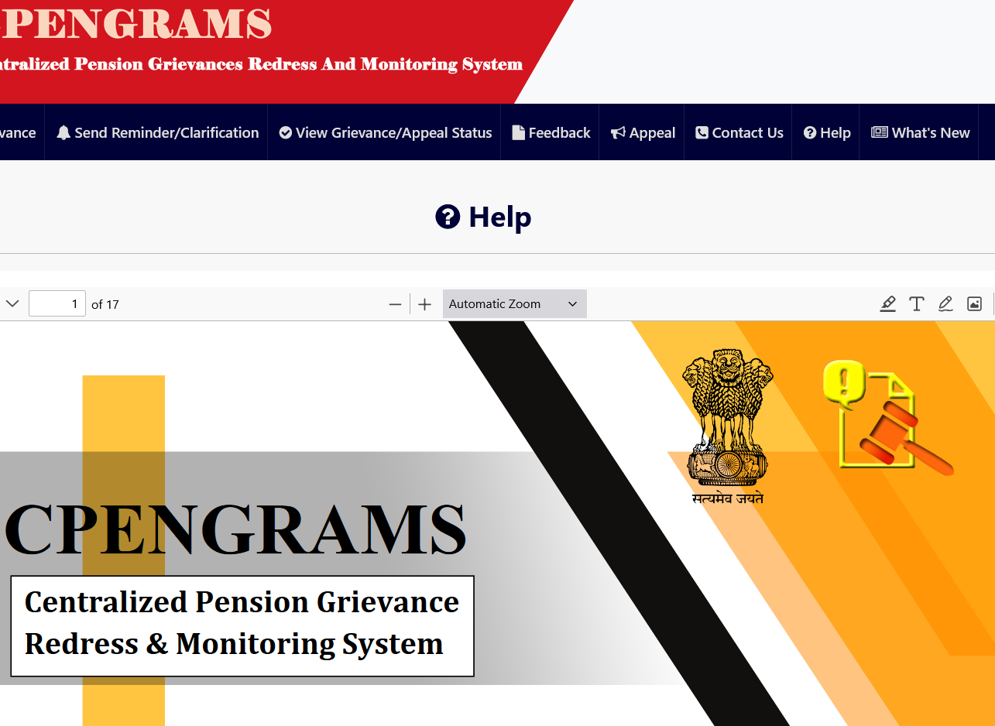
click
“help” : to know more

Slide 14
THANK YOU

